Slide 1

ONLINE APPOINTMENT BOOKING (HEALTHCARE)
Zohaib waqar
29 April 2025

Slide 2

Agenda
Introduction
Problem Statement & Scope
Business Requirements Document
Key Business Goals
Functional Requirements Document
Key Functional Requirements
Technical Design Document
Entity Relationship Diagram
Tools Used
BA Techniques Demonstrated
Challenges and Solutions
Conclusion

Slide 3

Digital platform for patients to book, reschedule, and cancel healthcare appointments online

Slide 4

Problem Statement & Scope
Problem:
Manual appointment booking caused double bookings, scheduling errors, lack of reporting​.
Scope:
In-Scope: Appointment scheduling, rescheduling, reminders, reporting​.
Out-of-Scope: Billing automation, patient diagnosis tracking.

Slide 5
Business Requirements Document
Purpose:
Identify business needs and major pain points​​.
Key Artifacts:
Use Case Diagram
System Context Diagram
BPMN Process Flow

Slide 6

Key Business Goals
Eliminate manual inefficiencies
Improve patient experience
Enable data-driven decisions through reporting

Slide 7
FUNCTIONAL Requirements Document
Purpose:
Detail the system's functional requirements​​.
Key Artifacts:
Registration Wireframe
Login Wireframe
Profile Management Wireframe
Appointment Booking Wireframe
Appointment History Wireframe
Reporting Wireframe

Slide 8
Key Functional Requirements
Real-time availability display
Appointment booking & rescheduling
Doctor schedule management
Enable data-driven decisions through reporting
Appointment reminders via SMS
Audit trails for accountability
Role-based access

Slide 9
Technical Design Document
Purpose:
Define architecture, data model, and technology choices​​.
Key Artifacts:
MVC (ASP.NET Core MVC framework)
MS SQL Server Database
Server-rendered HTML/CSS/JavaScript (Razor)​

Slide 10
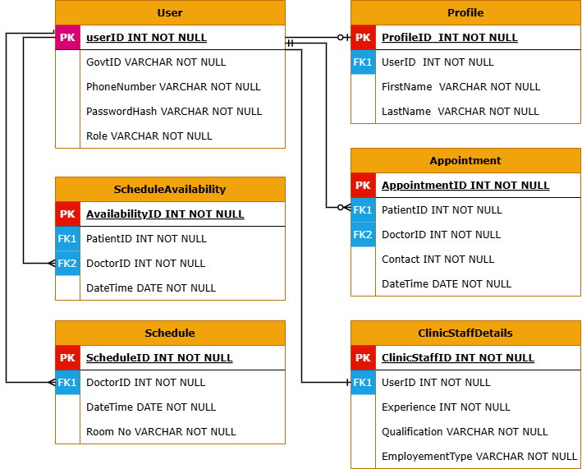
Entity Relationship Diagram (ERD)
Visual overview of entities: User, Profile, Appointment, Schedule​​.
​

Slide 11
REQUIREMENT ELICITATION Tools & TECHNIQUES
The requirement elicitation process involved a multi-faceted approach.
Conducted interviews to understand individual needs
Collaborative workshops to build consensus
Performed detailed document analysis to leverage existing resources
Technical Tools
MS Word
Lucid chart & Draw.io
GitHub

Slide 12
Selecting visual aids
Enhancing your presentation

Slide 13
Navigating Q&A sessions
Know your material in advance
Anticipate common questions
Rehearse your responses
Maintaining composure during the Q&A session is essential for projecting confidence and authority. Consider the following tips for staying composed:
Stay calm
Actively listen
Pause and reflect
Maintain eye contact

Slide 14

Speaking impact
Your ability to communicate effectively will leave a lasting impact on your audience
Effectively communicating involves not only delivering a message but also resonating with the experiences, values, and emotions of those listening

Slide 15
Dynamic delivery
Learn to infuse energy into your delivery to leave a lasting impression
One of the goals of effective communication is to motivate your audience
Impact factor | Measurement | Target | Achieved
Audience interaction | Percentage (%) | 85 | 88
Knowledge retention | Percentage (%) | 75 | 80
Post-presentation surveys | Average rating | 4.2 | 4.5
Referral rate | Percentage (%) | 10 | 12
Collaboration opportunities | # of opportunities | 8 | 10

Slide 16
Final tips and takeaways
Consistent rehearsal
Strengthen your familiarity
Refine delivery style
Pacing, tone, and emphasis
Timing and transitions
Aim for seamless, professional delivery
Practice audience
Enlist colleagues to listen & provide feedback
Seek feedback
Reflect on performance
Explore new techniques
Set personal goals
Iterate and adapt

Slide 17
Speaking engagement metrics
Impact factor | Measurement | Target | Achieved
Audience interaction | Percentage (%) | 85 | 88
Knowledge retention | Percentage (%) | 75 | 80
Post-presentation surveys | Average rating | 4.2 | 4.5
Referral rate | Percentage (%) | 10 | 12
Collaboration opportunities | # of opportunities | 8 | 10

Slide 18

Thank you
Brita Tamm
502-555-0152
brita@firstupconsultants.com
www.firstupconsultants.com

